Slide 1
Session 2: Legislative, normative and regulatory environment required to enable implementation and development of 4G/5G networks and innovative services
ITU/TSB
Hiroshi OTA

Slide 2
ITU-T SG15 - mandate
SG15 is responsible for the development of standards on:
optical transport network
access network
home network and power utility network infrastructures
equipment
systems
maintenance
optical fibres and cables and their related installation
instrumentation and measurement techniques
management
control plane technologies
test
to enable the evolution toward intelligent transport networks, including the support of smart-grid applications.

Slide 3
WP1 – Broadband Access
NG-PON2
Broadband access up to 2 Gbps
Next generation of converged
fiber access going to higher speeds
G.mgfast
Next generation G.fast targeting 5-10 Gbps
G.fast dynamic time
assignment (DTA)
downstream/upstream bit-rates
responsive to customer traffic
Visible Light
Communication for home networking
Powerline
communication (PLC)
for smart grid and
home networking
Continue collaboration with
Radio over fiber for mobile fronthaul
G.hn home networking over indoor phone, power, and coax wires >2 Gbps
G.RoF

Slide 4
WP2 – Optical Technologies
Optical Network
Infrastructure
Disaster Management
issues
Optical Fibre Technologies and Cables for easy and
environmentally friendly outside plants
Multichannel bi-directional DWDM
applications targeted at lower cost
optical solutions for applications including mobile fronthaul
and backhaul
200G
400G
Short-reach (OTN client) 200G and 400G interfaces reusing components developed for Ethernet applications
100G and future higher-rate
coherent multi-vendor interoperable interfaces

Slide 5
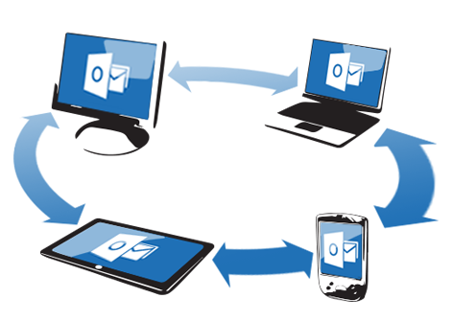
WP3 – Optical Transport Networks
Transport and synchronization supporting 5G mobile fronthaul and backhaul
Synchronization of packet
networks and future OTN
networks, e.g., beyond 100G
Architecture and other Transport SDN Aspects
Network survivability (protection and restoration)
New “B100G” OTN interfaces, including the use of coherent G.698.2 interfaces
under development
Management aspects of control and
transport planes
Core Information model enhancement for
management of synchronization and optical media
Equipment & management specifications for OTN, Ethernet and MPLS-TP

Slide 6
ITU-T Study Group 15 meetings
Geneva, 1-12 July 2019
Geneva, 27 January – 7 February 2020 (tentative)
Geneva, 7-18 September 2020 (tentative)

