Slide 1
Improving the security of consumer smart products: the UK’s Secure by Design Programme
Dominique Lazanski
Consultant
14 May 2019

Slide 2
Strategic context
Strategic Outcome 5: “The UK is more secure as a result of technology products and services having cyber security designed into them and activated by default.”

Slide 3
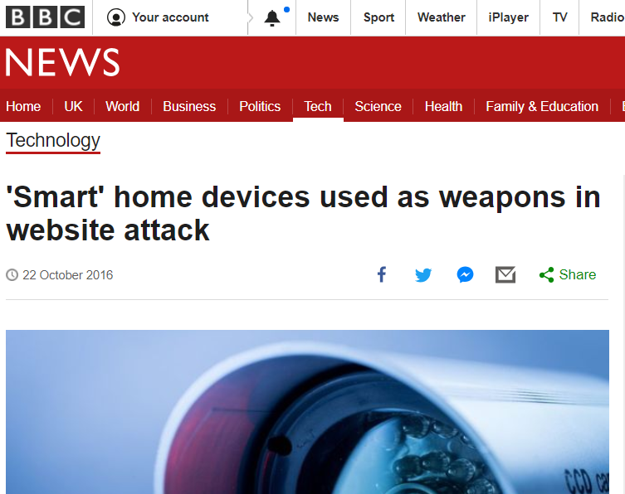
A growing challenge
12.9 billion consumer IoT devices by 2020 (Gartner 2017)
Many products are poorly secured.
Three key risks:

Slide 4
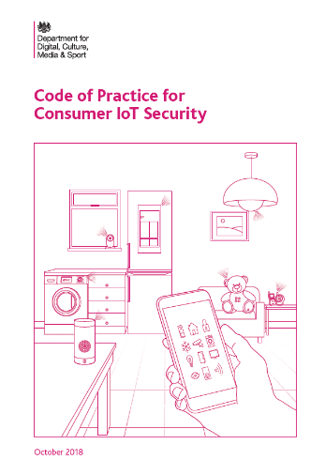
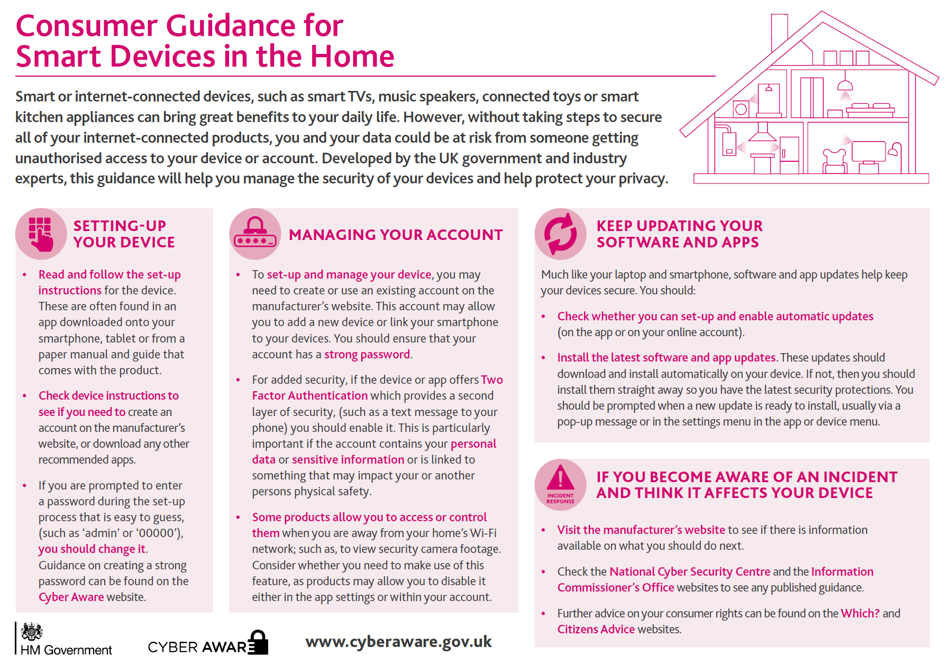
Programme milestones
Policy development – March 2018
Policy report
Supporting studies
Guidance – October 2018
Code of Practice for Consumer IoT Security
Mapping of the Code to existing guidance
Consumer guidance

Slide 5
Code of Practice for Consumer IoT Security
Brings together technical and procedural measures that are widely considered good practice.
Focuses on what matters most. Not a silver bullet to all problems.
Helps ensure GDPR compliance.
10) Monitor system telemetry data
11) Make it easy to delete personal data
12) Make installation and maintenance easy
13) Validate input data
9) Make systems resilient to outages
1) No default passwords
2) Implement a vulnerability disclosure policy
3) Keep software updated
4) Securely store credentials and sensitive data
8) Ensure that personal data is protected
7) Ensure software integrity
6) Minimise exposed attack surfaces
5) Communicate securely

Slide 6
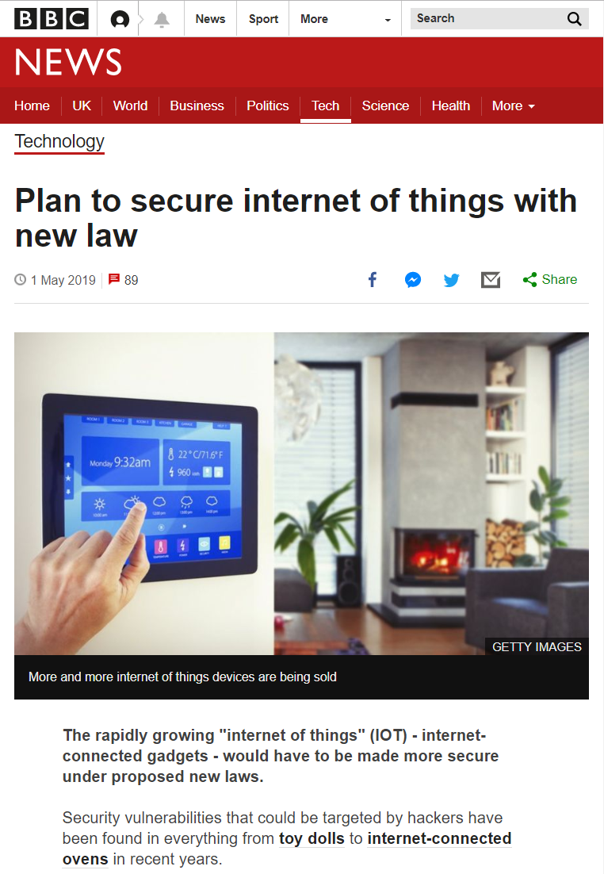
May 2019: Proposals for UK regulation
To remove products with the poorest security from shelves.
Retailers to only stock products with a security label, which indicates adherence with the top 3 guidelines of the Code of Practice.
This would be the first step of a longer, staged approach to regulation.

Slide 7
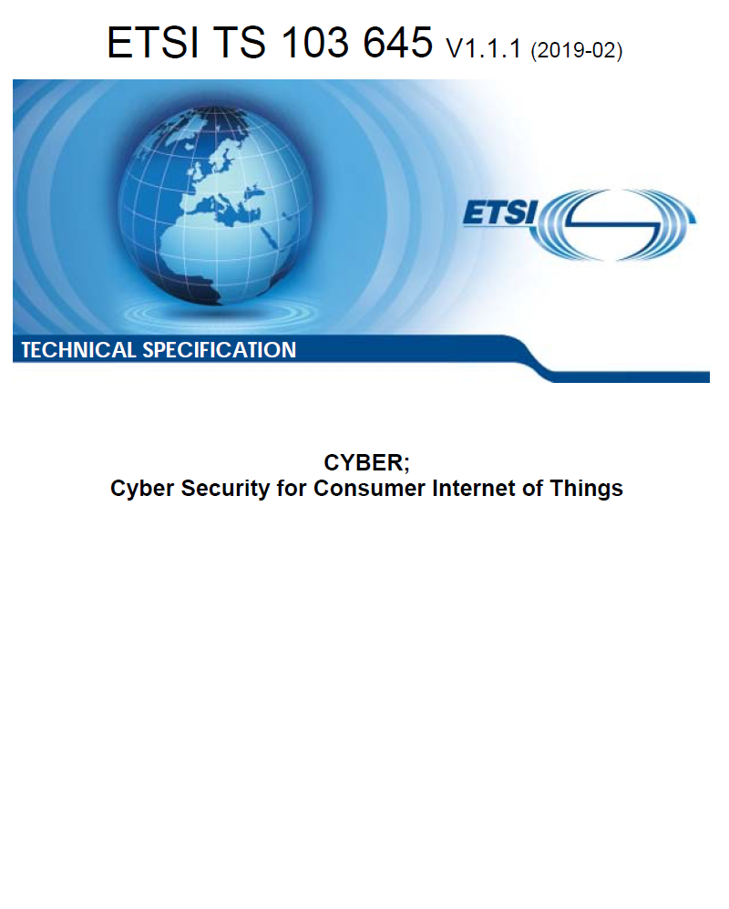
February 2019: ETSI Technical Specification
The first globally-applicable industry standard.
Informed by UK Code of Practice, designed for wider European and global needs.
“Cybersecurity Tech Accord Signatories Endorse ETSI Technical Specification for IoT Security”
Ambition to develop into a European Standard (EN) and to inform a Europe-wide certification scheme under the EU Cyber Security Act.

Slide 8
More information
Secure by Design programme: https://www.gov.uk/government/collections/secure-by-design
Consultation on regulatory proposals open until 5 June
ETSI Technical Specification 103 645: https://www.etsi.org/newsroom/press-releases/1549-2019-02-etsi-releases-first-globally-applicable-standard-for-consumer-iot-security

